Slide 1
The Problem: 如何從植物幼苗中分辨出雜草

Slide 2
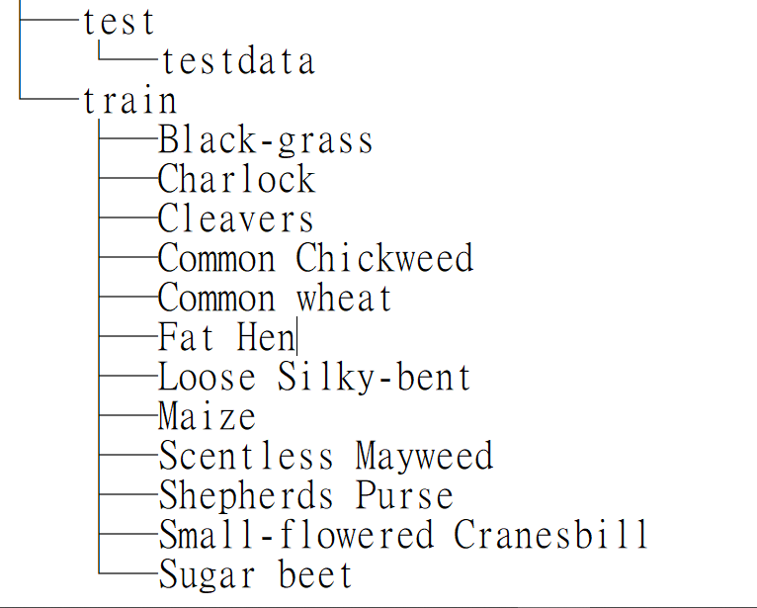
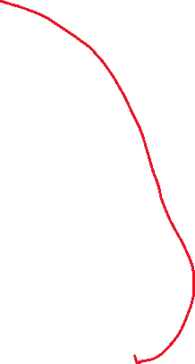
照片資料夾

Slide 3
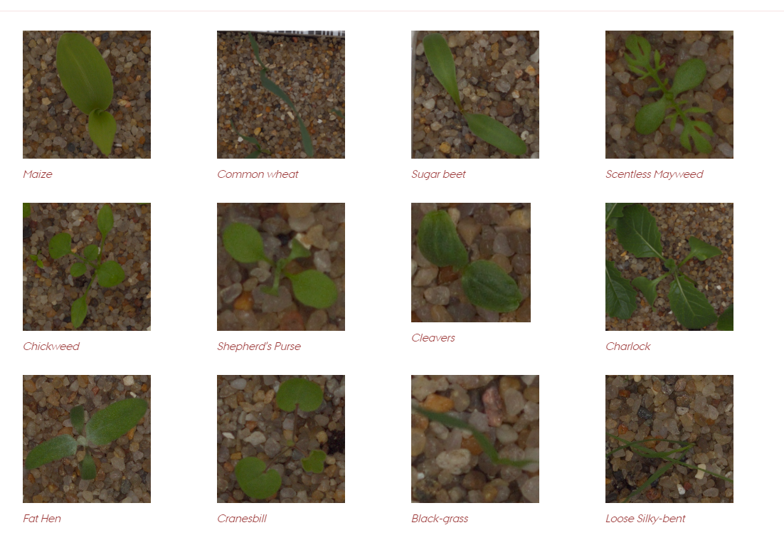
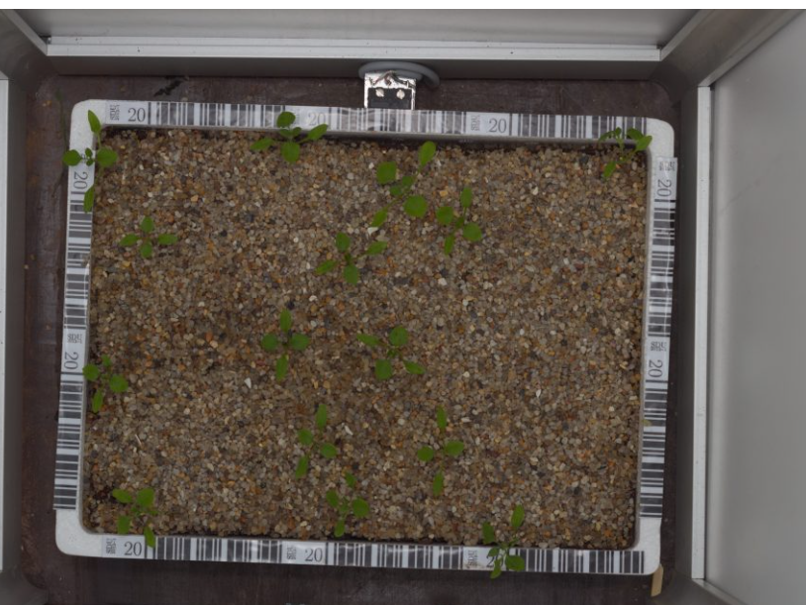
The Dataset: 12種植物的幼苗

Slide 4
Survey and Preliminaries
Method 1 : Kumar Shridhar
Method 2 : Filter Green

Slide 5
Method 1 : Kumar Shridhar

Slide 6
Step 1 : Analysis the Dataset

Slide 7
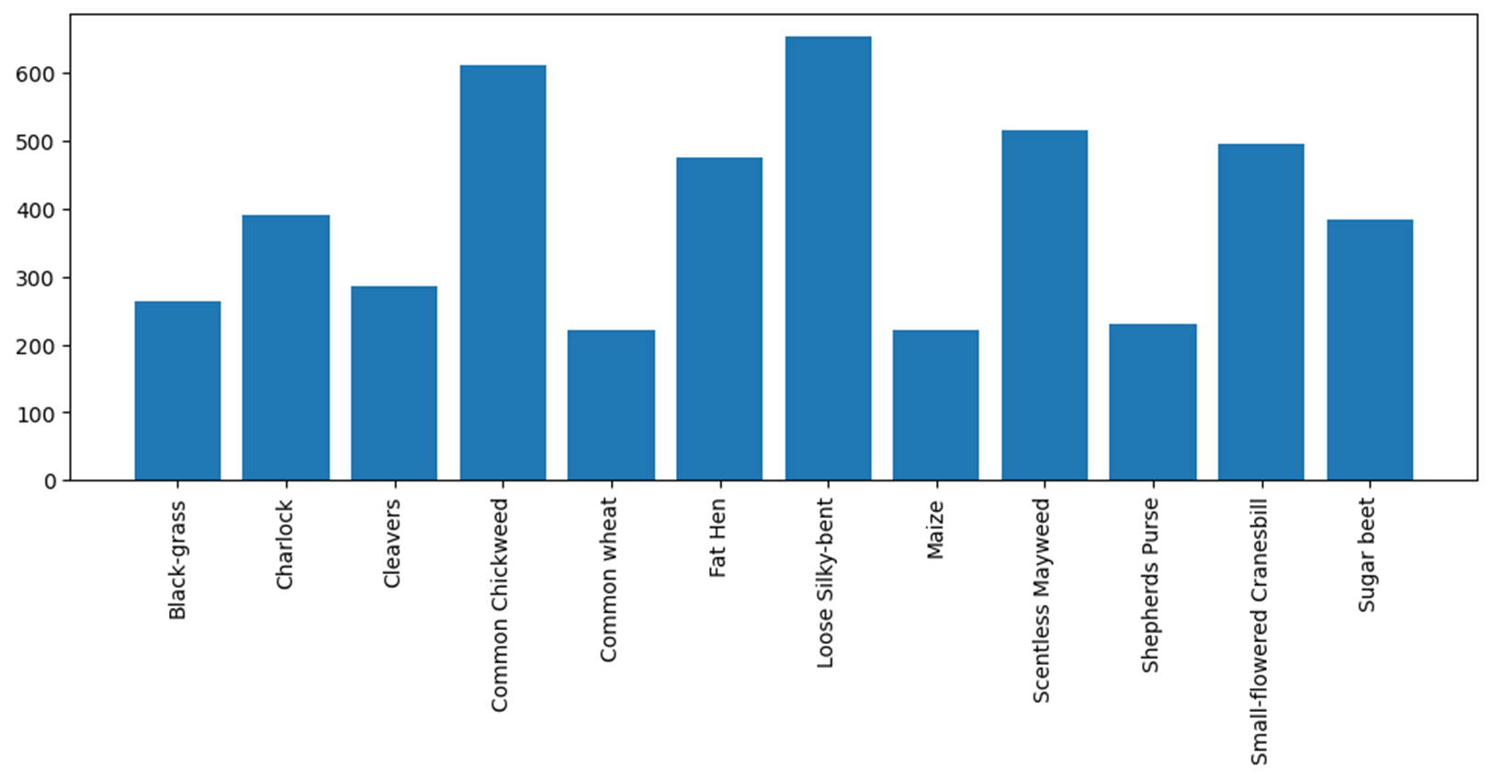
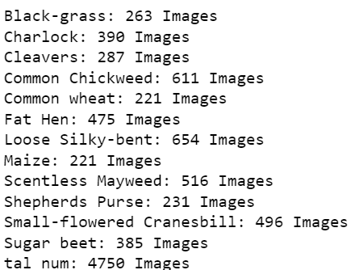

The Total Number

Slide 8
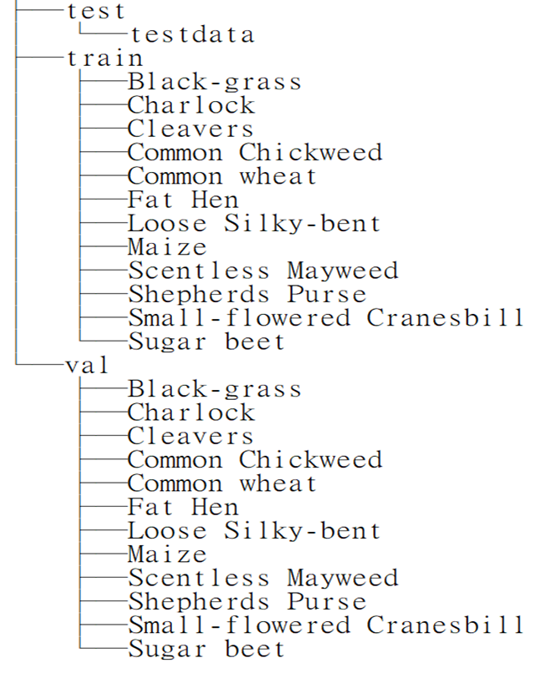
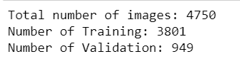



Train_validation_split

Slide 9
Step 2 : Convolution Neural Network (CNN)

Slide 10
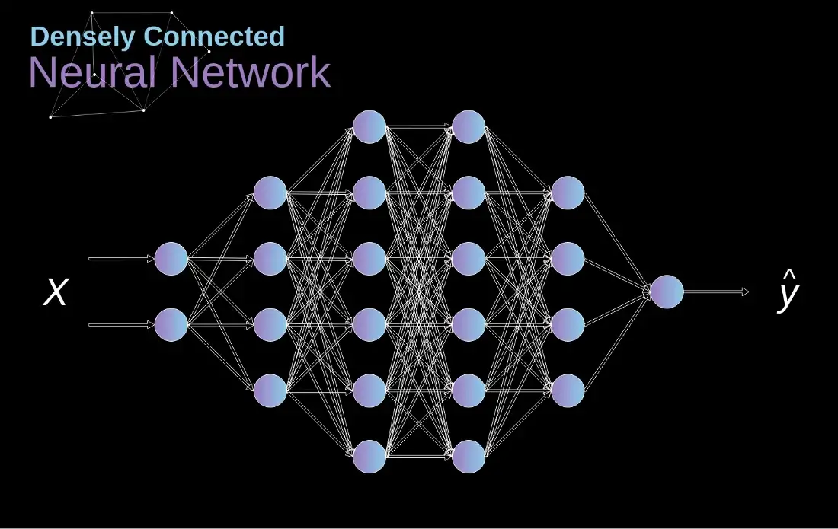

Slide 11
What is CNN ?
Convolution +ReLU+ Maxpooling

Slide 12
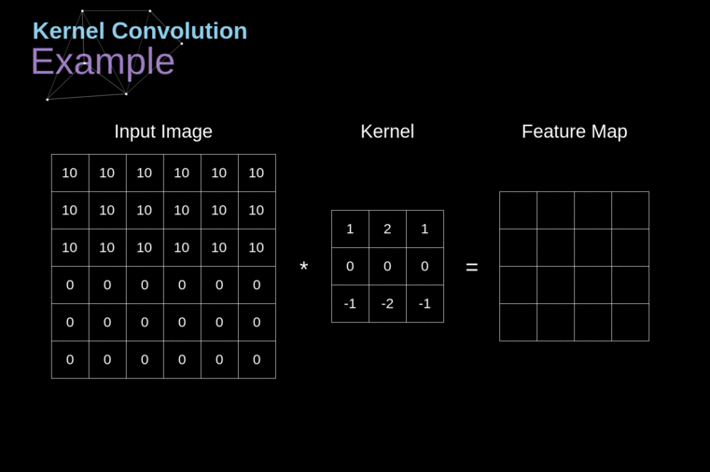
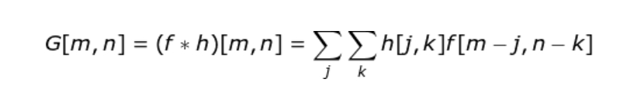

Slide 13
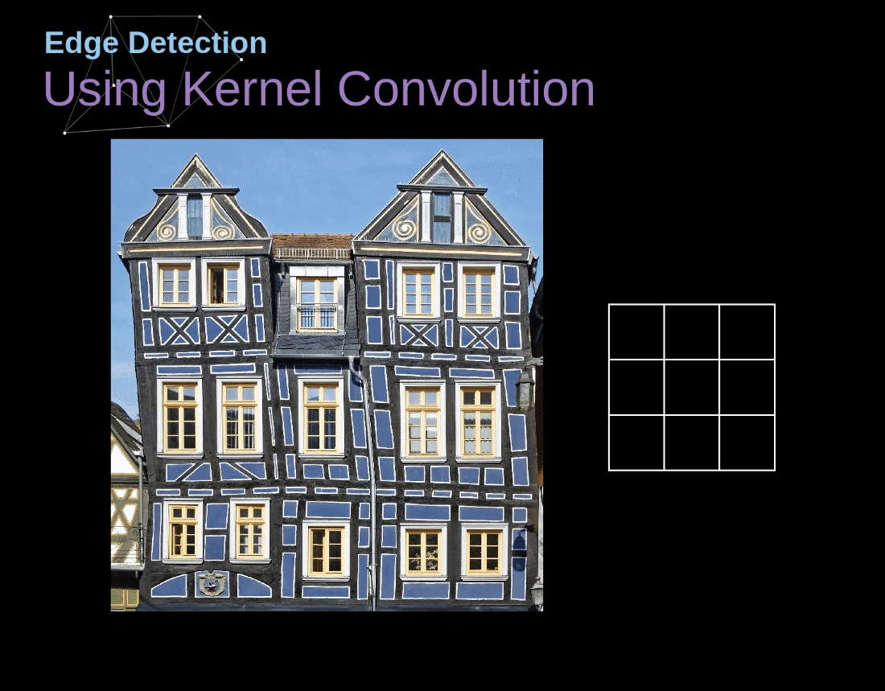

Slide 14
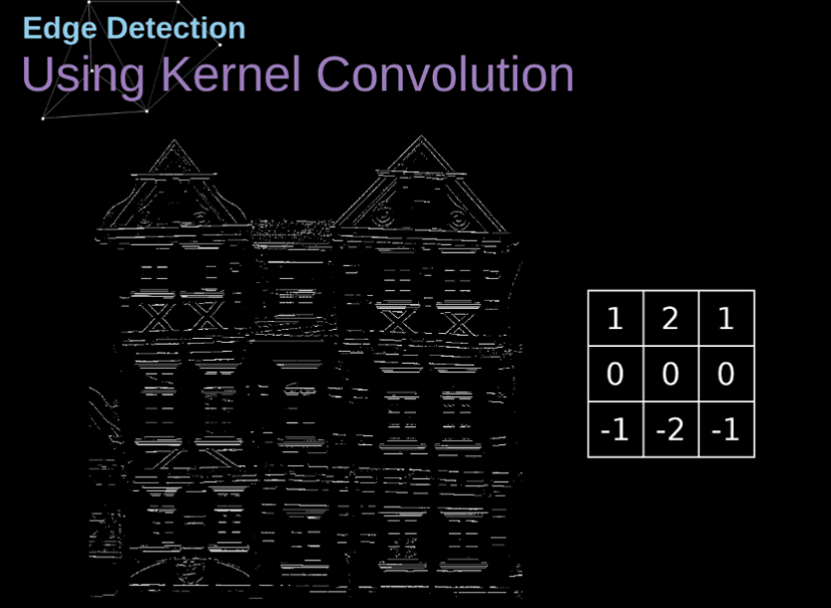

Slide 15
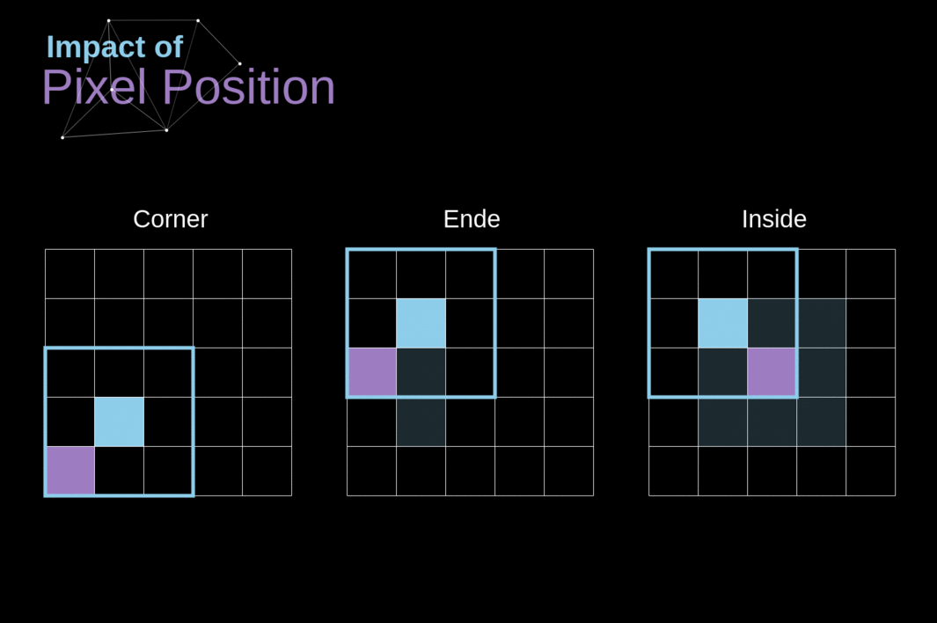

Slide 16
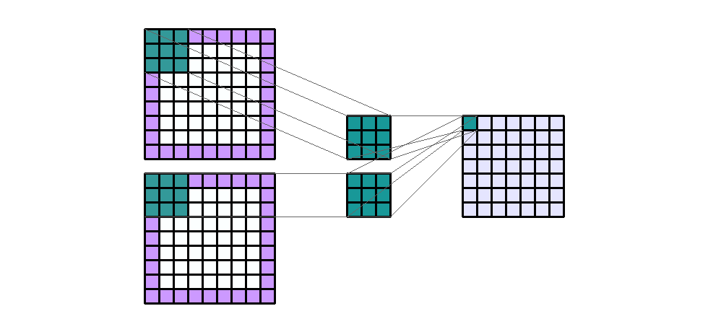
Solution : Padding

Slide 17

Activation : ReLU

Slide 18
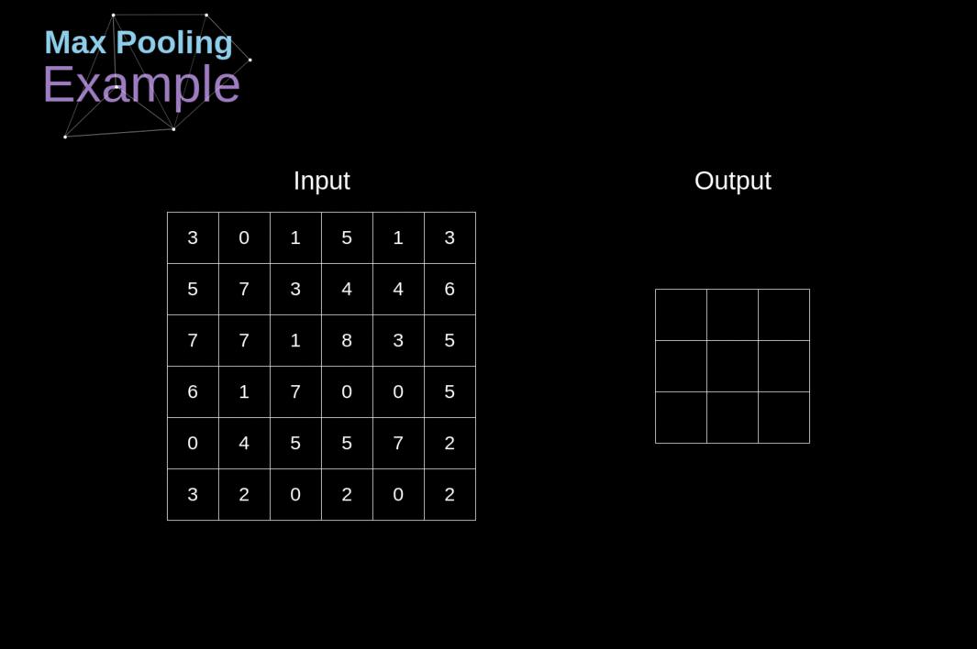

Slide 19
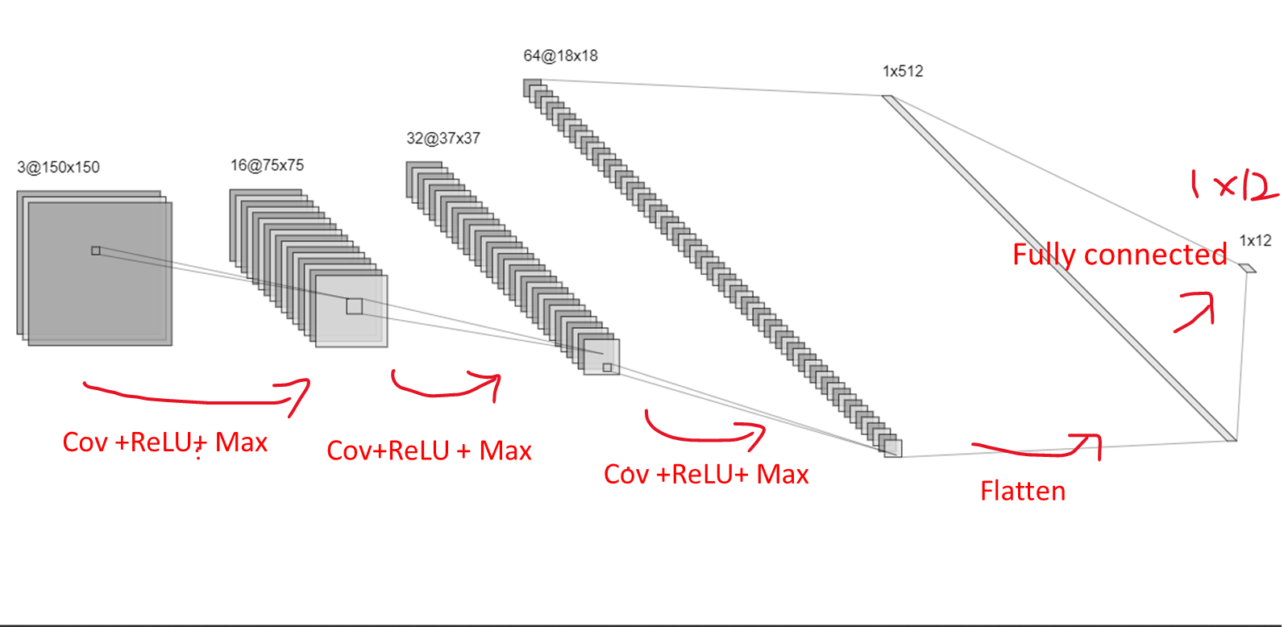
Set Up the Model

Slide 20
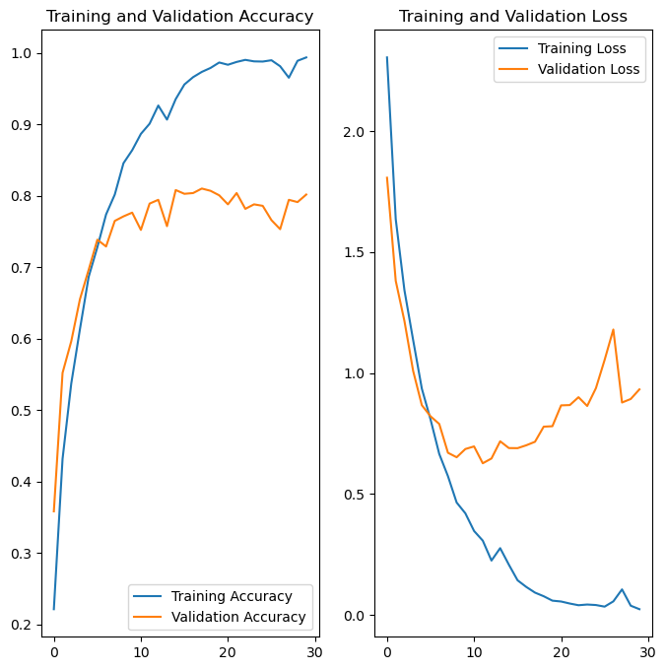
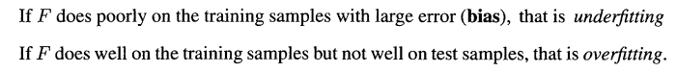
40 Minutes of Training
Overfitting!

Slide 21
How to solve overfitting ?
Stop the minimization early before you overfit.
Less freedom and less parameter

Slide 22
Step 3 : CNN with Augmentation

Slide 23
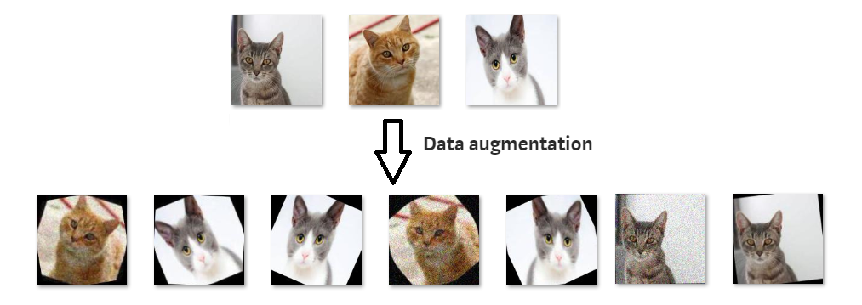
Image Augmentation

Slide 24
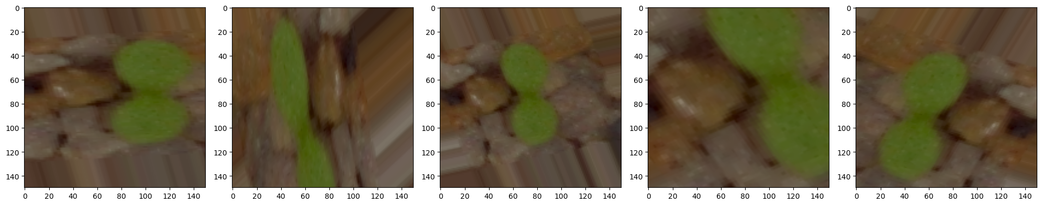
Image Augmentation on our Data

Slide 25
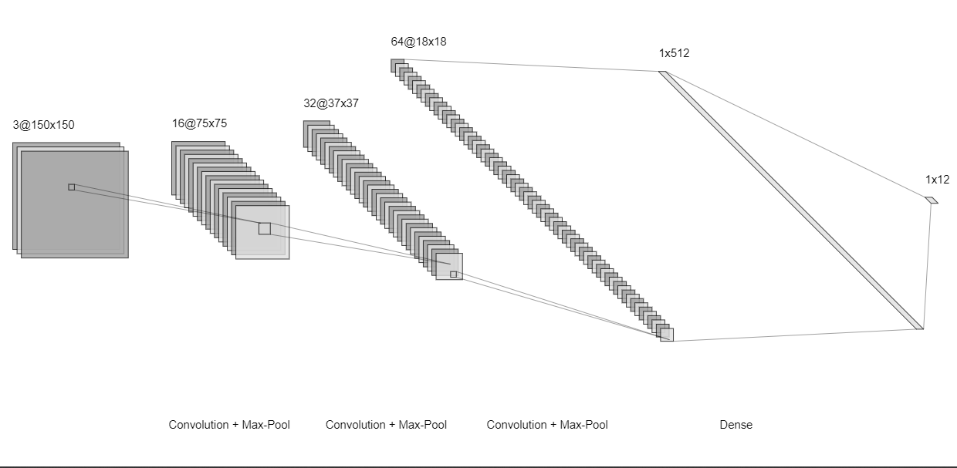
Train Again !
Fully connected
Cov +ReLU+ Max
Cov+ReLU + Max
Cov +ReLU+ Max
Flatten

Slide 26
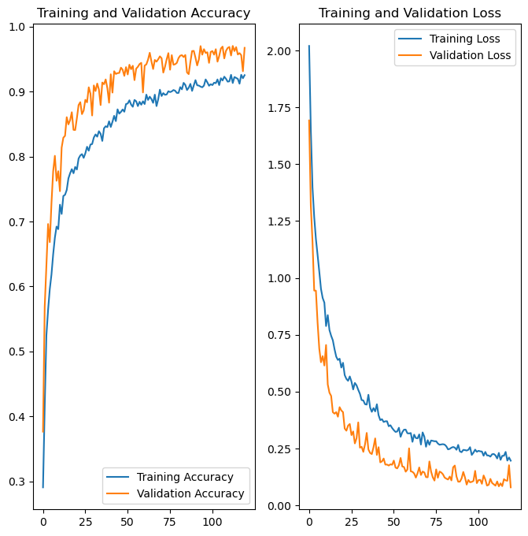
1 Hours of Training
Train acc : 0.92
Validation : 0.97

Slide 27
Step 4 : Transfer Learning

Slide 28
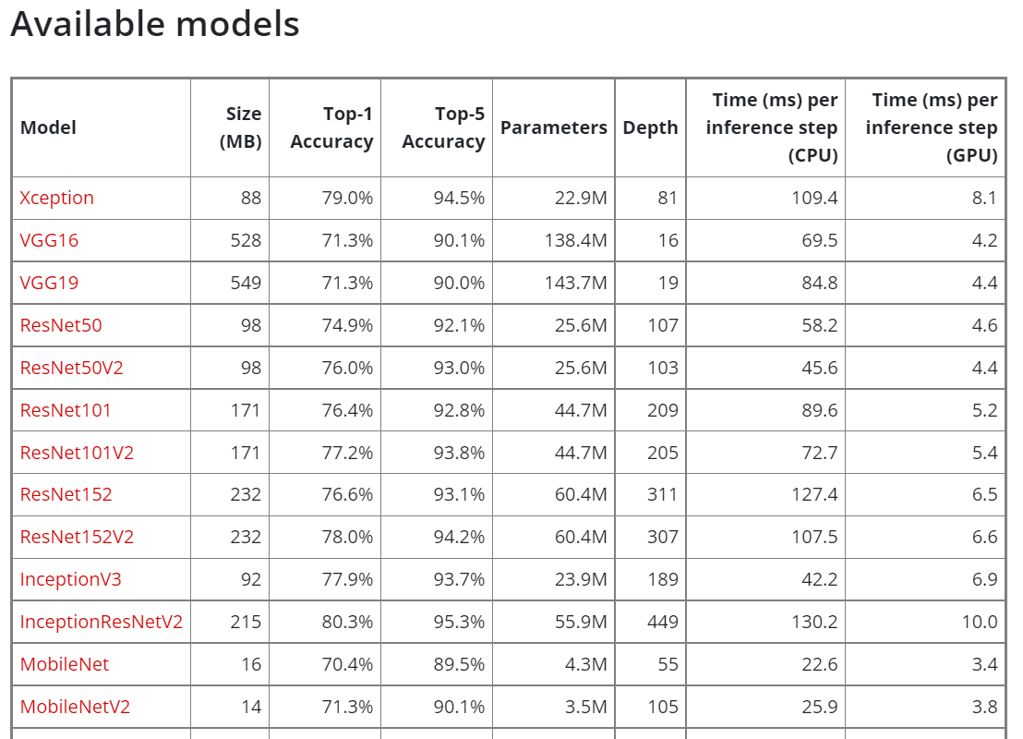


Slide 29
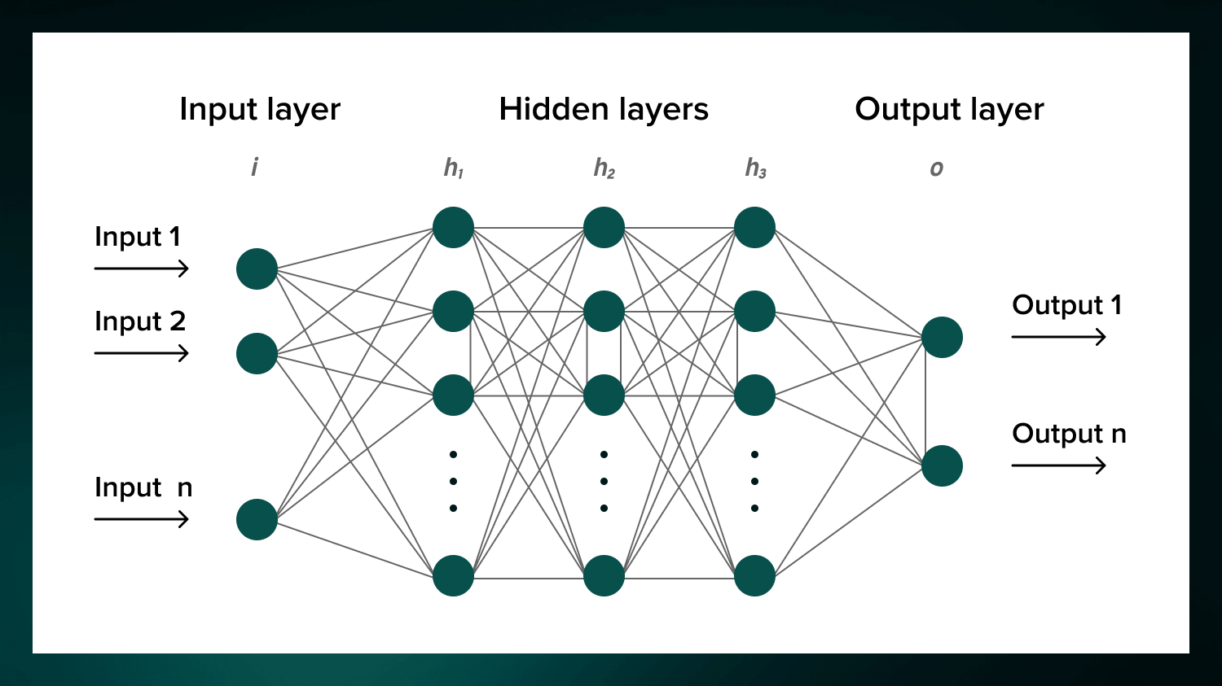


Step 4-1 : Loose Some Layers
Trainable

Slide 30
Step 5 : Balance the Data

Slide 31

Recall the Bar Chart

Slide 32
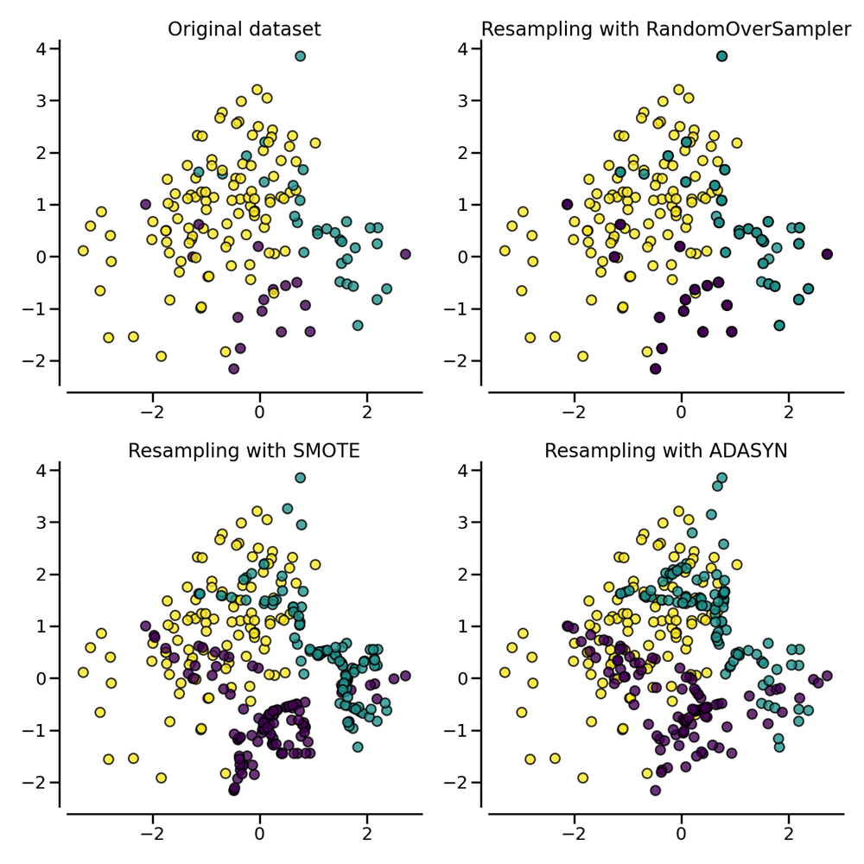

Over-sampling : SMOTE and ADASYN

Slide 33
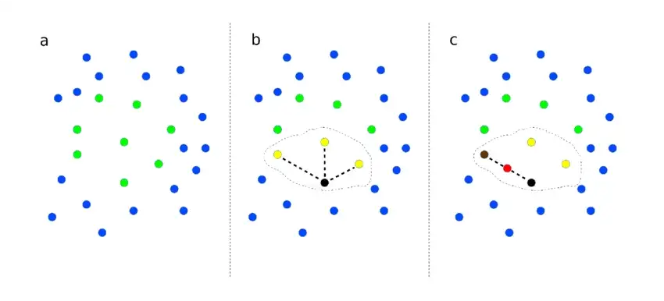
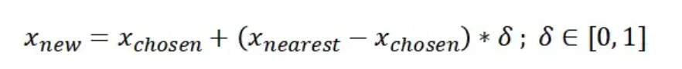
What is SMOTE ?

Slide 34
Resample this

Slide 35
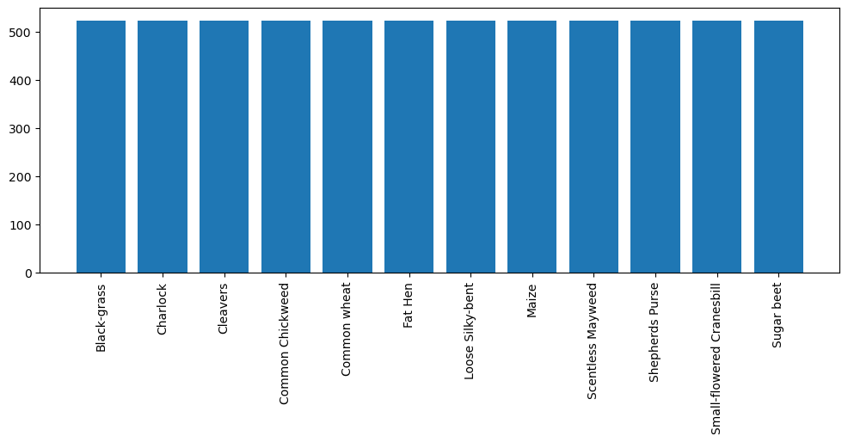
To this

Slide 36
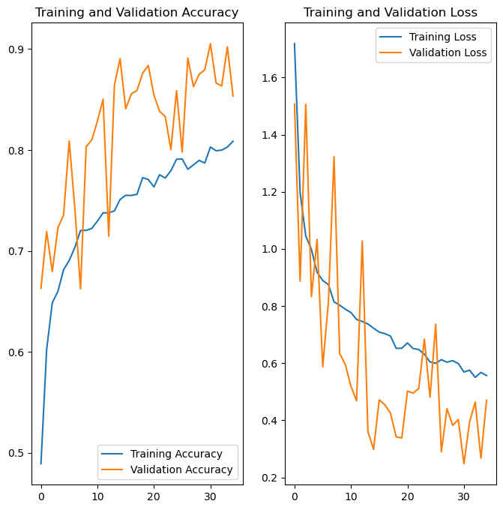
1 hours training
Train acc : 0.81
Validation : 0.85

Slide 37
Method 2 : Filter Green

Slide 38
Since the seedlings are all green,

Slide 39
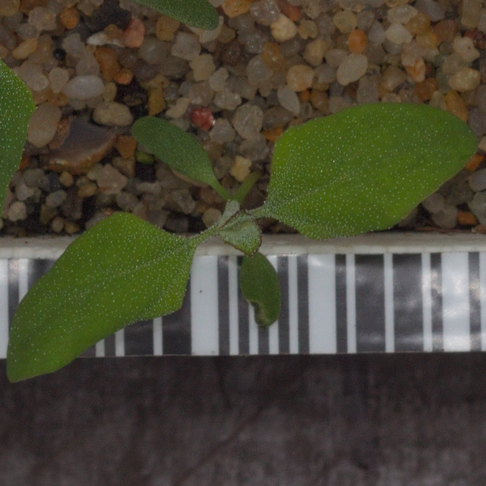
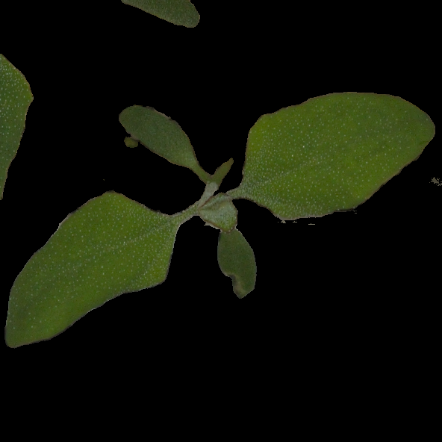
Make the non-green black

Slide 40
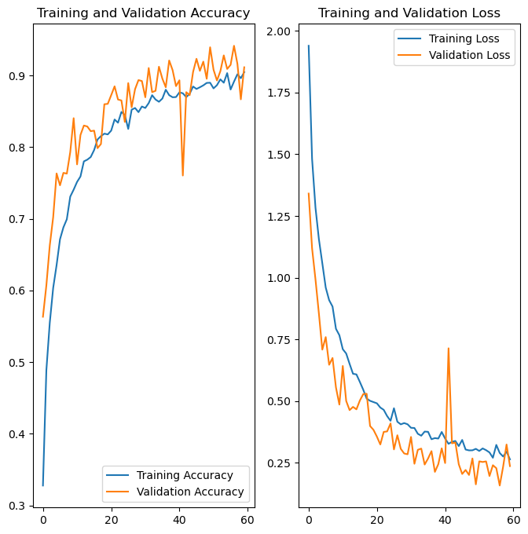
1 hours
Train acc : 0.90
Validation : 0.91

Slide 41
Development of Potential Improvement Skills
Method 3 : 2+1
Method 4 : grey

Slide 42
Method 3 : Method 2+1

Slide 43

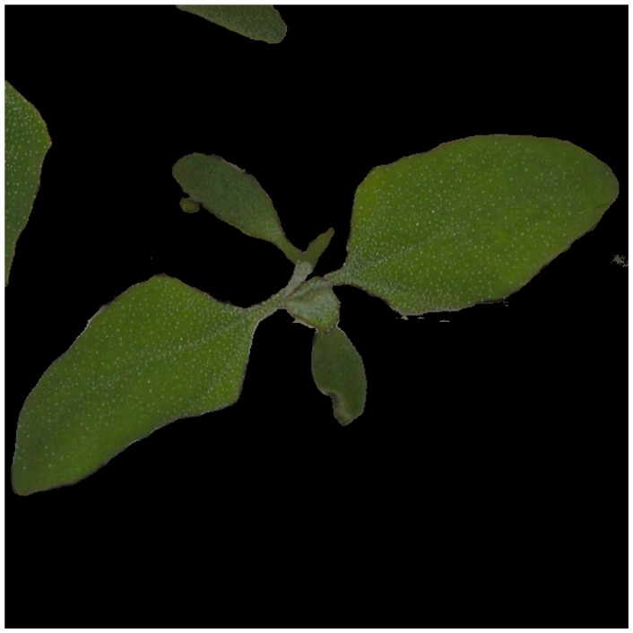
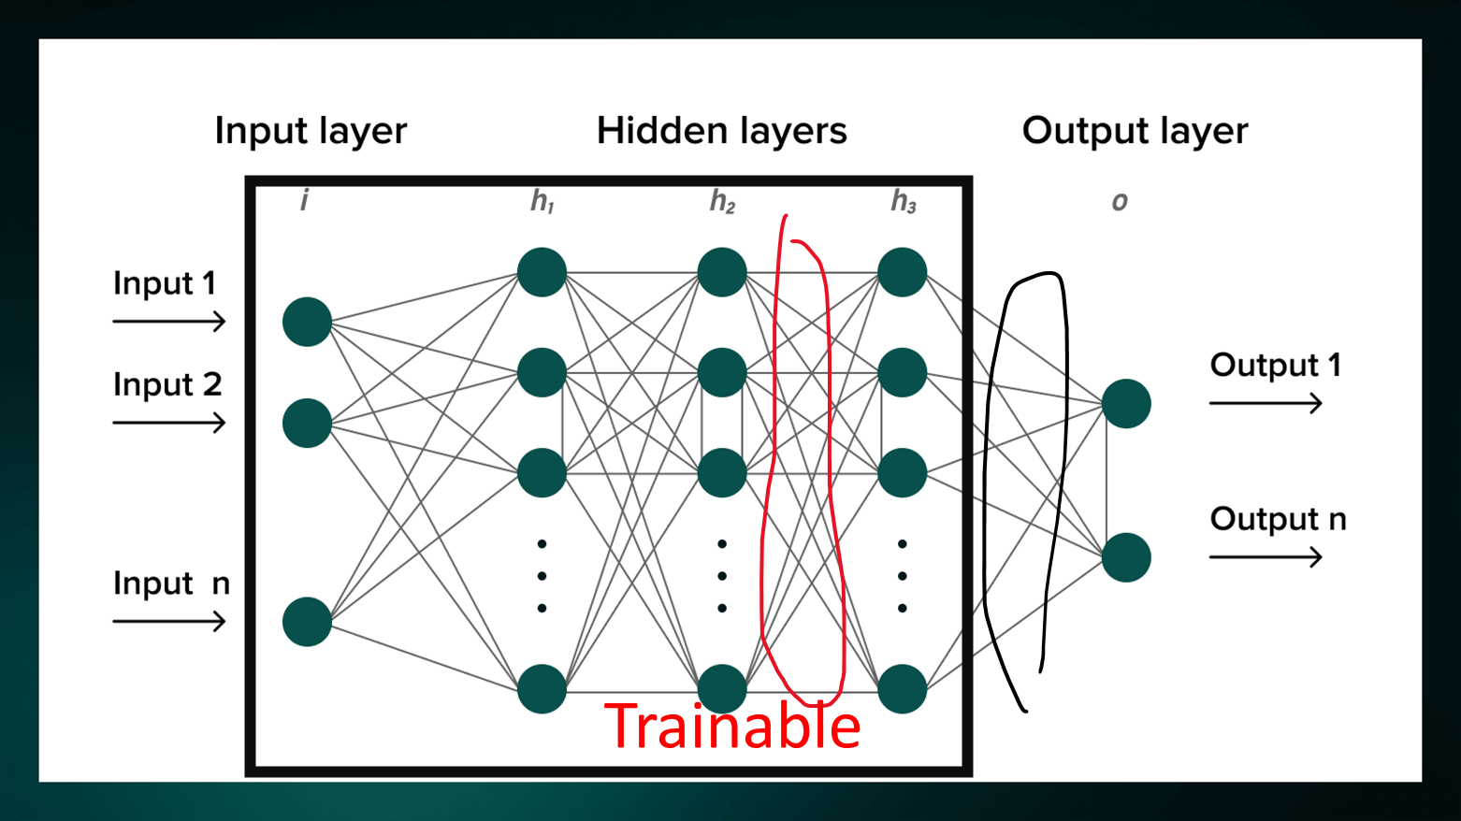

SMOTE
MobileNet

Slide 44
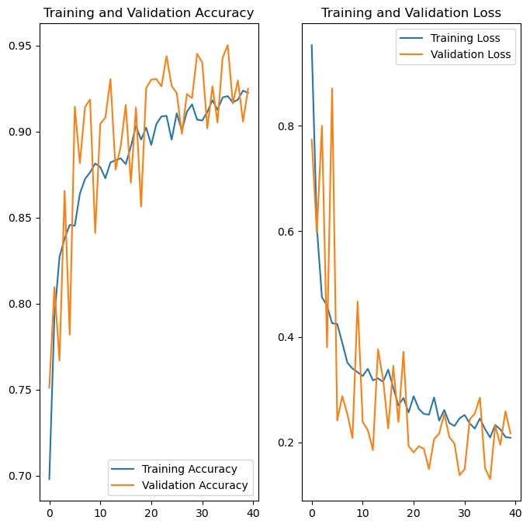
1 hours
Train acc : 0.92
Validation : 0.92

Slide 45
Method 4 : Grayscale + Method 3

Slide 46
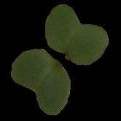
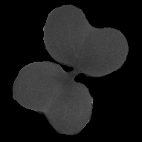
More black is more 0 !

Slide 47
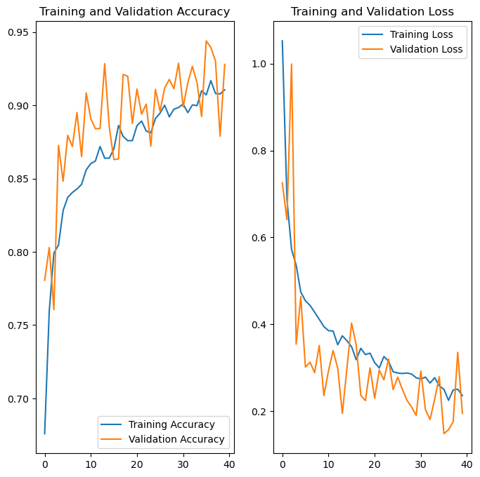
1 hours
Train acc : 0.91
Validation : 0.93

Slide 48
Comparison
Method | 1-1 (raw CNN) | 1 (Resam+ Transfer) | 2 (green) | 3 (2+1) | 4 (grey)
Train accuracy | 0.92 | 0.81 | 0.90 | 0.92 | 0.91
Validation accuracy | 0.97 | 0.85 | 0.91 | 0.92 | 0.93
F1 score | 0.94 | 0.77 | 0.89 | 0.84 | 0.78
Run time | 1 hours

Slide 49
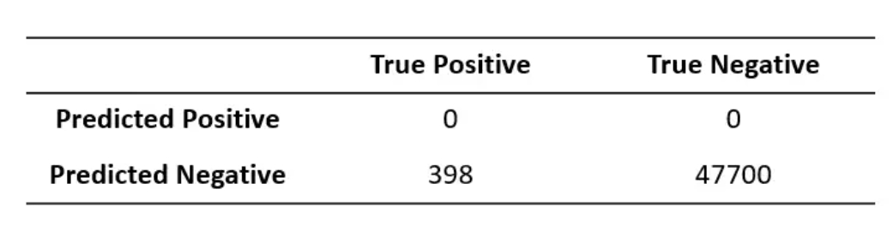
What is F1-score
Accuracy = 47700/(47700+398) = 99.2% !!

Slide 50

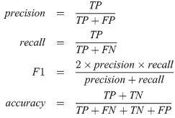
To avoid : Use F1-score
TP(真陽性)
FP(真陽性)
FN(真陽性)
TN(真陽性)

Slide 51
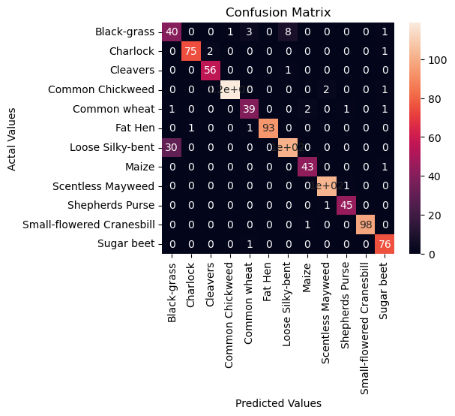
Confusion Matrix: Method 1-1 (raw CNN)

Slide 52

Confusion Matrix: Method 1 (resam+transfer)

Slide 53
Confusion Matrix: Method 2 (green)

Slide 54

Confusion Matrix: Method 3 (2+1)

Slide 55

Confusion Matrix: Method 4 (grey)

Slide 56
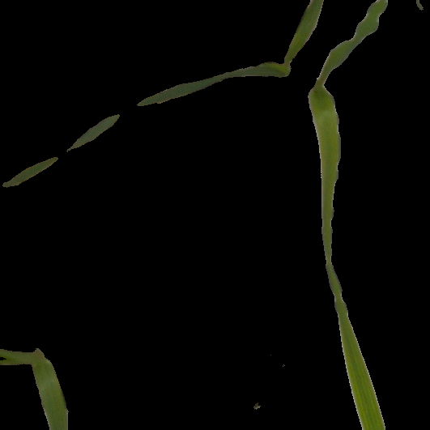
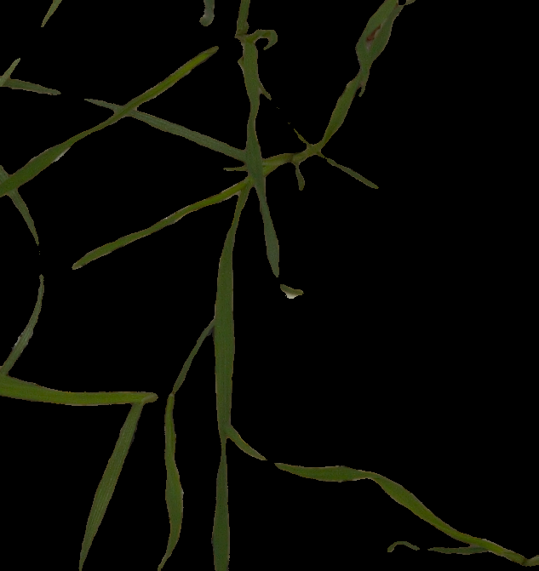
Black-grass vs Loose Silly-bent

Slide 57
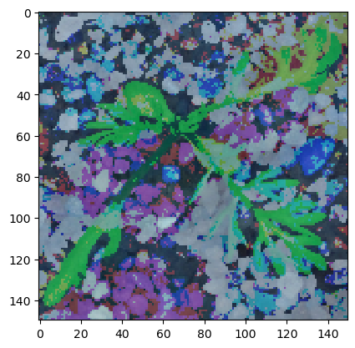
Conclusion and Remarks
遷移學習的預訓練模型怎麼挑 ?
檢查這個預訓練模型是用什麼訓練集訓練的，如果與問題的訓練及相似的話，就可以選擇。
Mean Silhouette Coefficient : 使用平均輪廓係數計算編碼對目標數據的聚類程度，選擇產生最高輪廓係數的源模型作為遷移學習的源模型。
先綠化再做過取樣 與 先做過取樣再做綠化 有差別嗎?
有差別。因為先做綠化代表樣本之間的距離被改變了。

Slide 58
Conclusion and Remarks
為什麼improvement沒有improve結果?
可能MobileNet的參數還是太少了，雖然有鬆開幾層，把可訓練參數增加到一百萬，但比起 Raw CNN 有兩百萬個可訓練參數還是有差
為什麼ReLU比Sigmoid好?
因為ReLU的計算很簡單，程式碼只需要一行 ‘If’ 判斷式就可以完成了。

Slide 59
References-1
https://arxiv.org/pdf/1608.03983.pdf
http://www.datakit.cn/blog/2017/02/05/t_sne_full.html
https://serokell.io/blog/introduction-to-convolutional-neural-networks
https://stanford.edu/~shervine/teaching/cs-230/cheatsheet-convolutional-neural-networks
https://towardsdatascience.com/activation-functions-neural-networks-1cbd9f8d91d6
https://towardsdatascience.com/gentle-dive-into-math-behind-convolutional-neural-networks-79a07dd44cf9
https://towardsdatascience.com/upsampling-with-smote-for-classification-projects-e91d7c44e4bf
https://medium.com/%E6%95%B8%E5%AD%B8-%E4%BA%BA%E5%B7%A5%E6%99%BA%E6%85%A7%E8%88%87%E8%9F%92%E8%9B%87/smote-enn-%E8%A7%A3%E6%B1%BA%E6%95%B8%E6%93%9A%E4%B8%8D%E5%B9%B3%E8%A1%A1%E5%BB%BA%E6%A8%A1%E7%9A%84%E6%8E%A1%E6%A8%A3%E6%96%B9%E6%B3%95-cdb6324b711e
https://amielmeiseles.medium.com/how-to-choose-the-best-source-model-for-transfer-learning-41d5c91c1338

Slide 60
References-2
https://chtseng.wordpress.com/2018/01/19/kaggle-%E7%99%BC%E8%8A%BD%E6%A4%8D%E7%89%A9%E5%88%86%E9%A1%9E/
https://www.youtube.com/watch?v=ZCdbc9Ta1Ks
https://www.youtube.com/watch?v=NWONeJKn6kc&t=176s
https://ml001.netlify.app/pages/syllabus.html
https://learn.udacity.com/courses/ud187
https://medium.com/analytics-vidhya/image-augmentation-9b7be3972e27
https://medium.com/neuralspace/kaggle-1-winning-approach-for-image-classification-challenge-9c1188157a86
https://cloud.tencent.com/developer/article/1950152
https://blog.csdn.net/playezio/article/details/80449568
https://medium.com/neuralspace/kaggle-1-winning-approach-for-image-classification-challenge-9c1188157a86

Slide 61
Method 5 : CNNs + SVM

Slide 62
CNNs

Slide 63
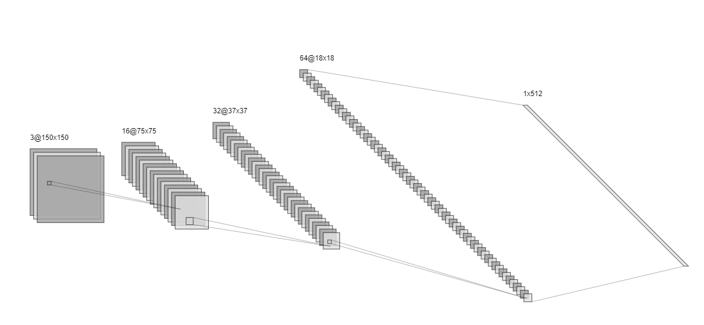



CNNs + SVM

Slide 64
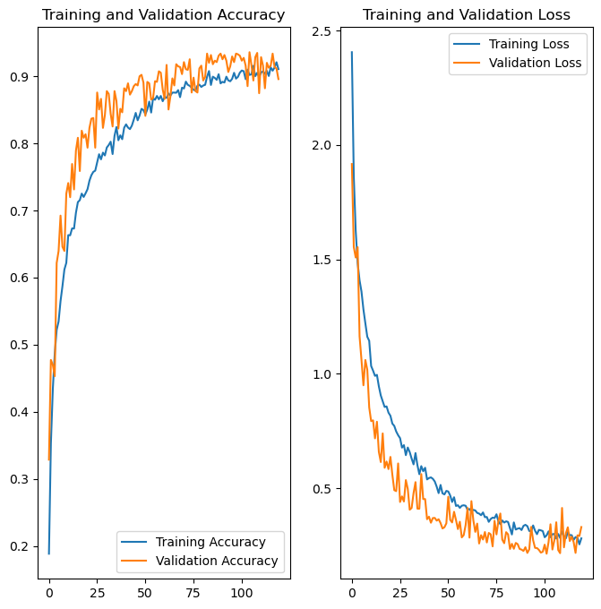
1 hours
Train acc : 0.91
Validation : 0.9
F1-score : 0.9

